Slide 1

Predicting Influencers in Social Network
Under the Guidance of
Guide Name: Dr K Adi Narayana Reddy
Designation: Associate Professor
Team: 11
16WH1A1214 - D.Pravalika
16WH1A1238 - K.Sai Keerthi
16WH1A1246 - M.Sriya Sri

Slide 2
Contents
Introduction
Problem Definition
Literature Survey
Existing System
Proposed System
Architecture Diagram
Module(s)
Plan of Action
References

Slide 3

Introduction
In recent years, social network plays an increasingly signiﬁcant role in our daily lives. We share our experiences and opinions with our friends on Facebook, Twitter, Instagram and so on.
According to the research in Sociology, inﬂuencers have a great impact on other people’s lives because people always tend to follow the opinions of these inﬂuencers in social networks.

Slide 4

Problem Definition
It is important for us to ﬁgure out which persons are inﬂuencers and how they shape public opinions. In our project, the goal is to ﬁnd inﬂuencers in a speciﬁc social network— Twitter.
Given two persons and their social network features, our job is to predict which one is more influential.
Who is the most influencing person?

Slide 5
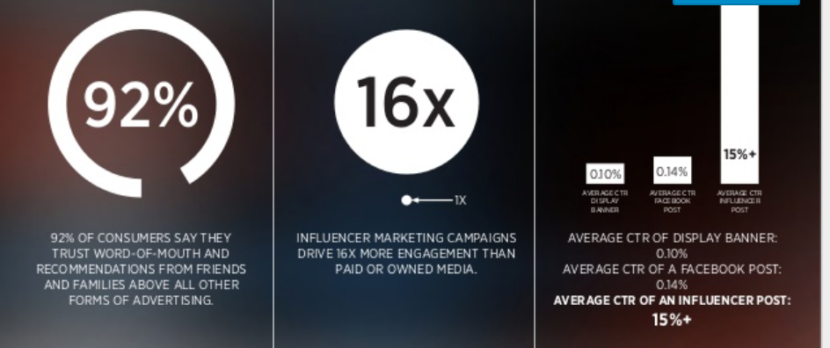
Literature Survey
Influencer marketing has emerged as one of the fastest-growing social marketing practices as brand marketers look to connect with consumers and customers .
It represents a form of Word of Mouth marketing, in which satisfied consumers tell other people how much they like a product, service, business or event.

Slide 6

Existing System & Proposed System
Follower Count Benchmark
● In the proposed system, we are trying to implement different machine learning algorithms and analyse which attribute among those 11 pre-computed, non-negative attributes based on Twitter activity provided have more significance.
1. #followers 2. # followings 3. # listed
4. #mentions received 5. #retweets received
6. # mentions sent 7. # retweets sent
8. # posts 9. #network feature1
10. # network feature2 11. # network feature3

Slide 7
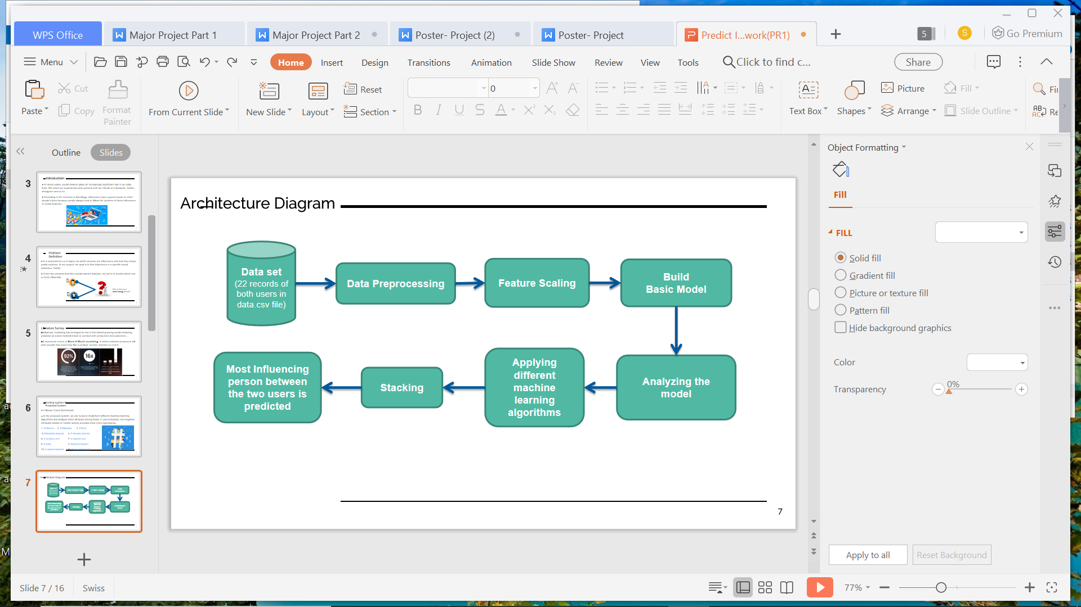
Architecture Diagram

Slide 8
Modules
Module 1: Upload the training data from the Dataset Folder.
Module 2: Preprocess the uploaded data. We are checking for duplicates and removing them, Scaling the data, Spliting the data into train and test samples.
Module 3: Build the model for Logistic Regression, SVM, Naive Bayes, MLP and Random Forest for all the features.
Module 4: Now we apply Stacking to the previous models and their accuracy is determined.
Module 5: As we see, Stack model has best accuracy. Now we predict new test samples and most influencing person is determined.

Slide 9
Data Preprocessing
Importing Libraries
Importing Dataset
Checking for missing values
►Removing duplicates
→ using “drop_duplicates()”
Splitting Dataset into Train and Test Sets
Feature Scaling
►StandardScaler
►MinMaxScaler

Slide 10
Alogorithms
Logistic Regression
Support vector machine
Naïve Bayes Classifier Algorithm
Multilayer perceptron (MLP)
Random Forest
Stacking Model

Slide 11
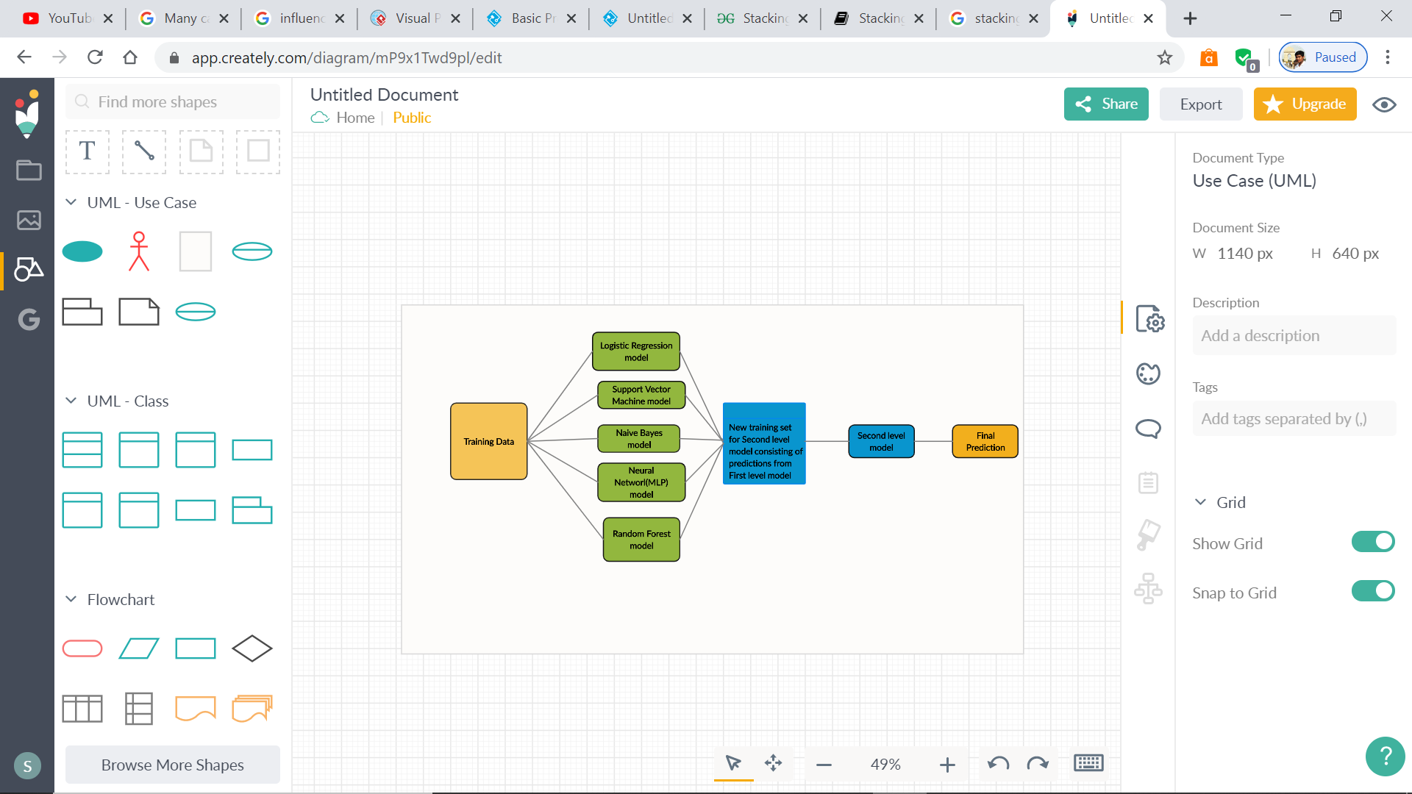
Stacking

Slide 12
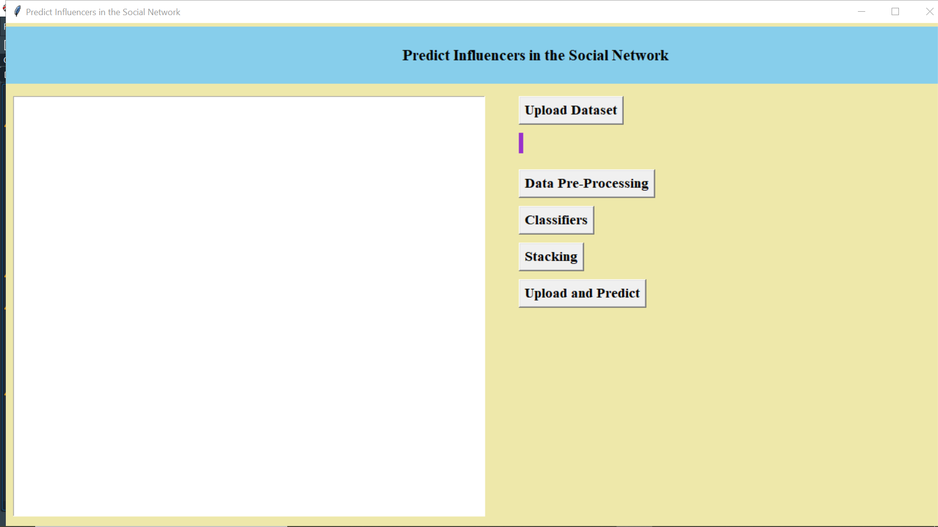
Output Screenshots

Slide 13
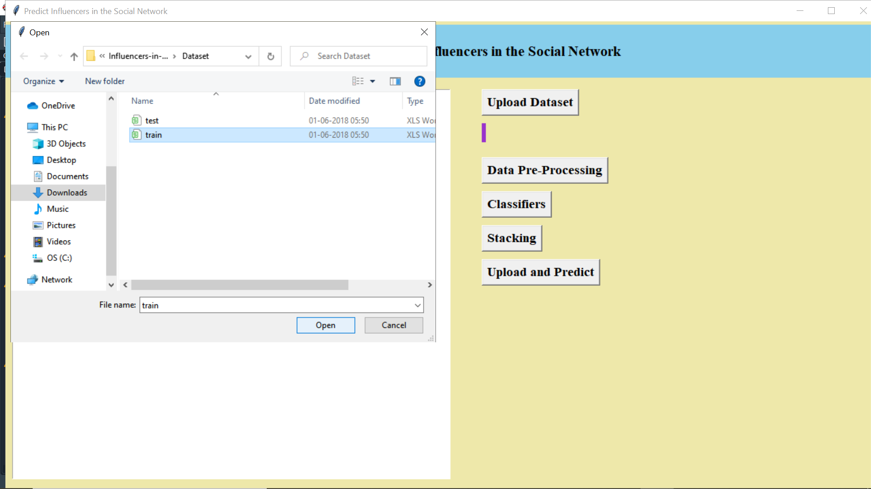

Slide 14
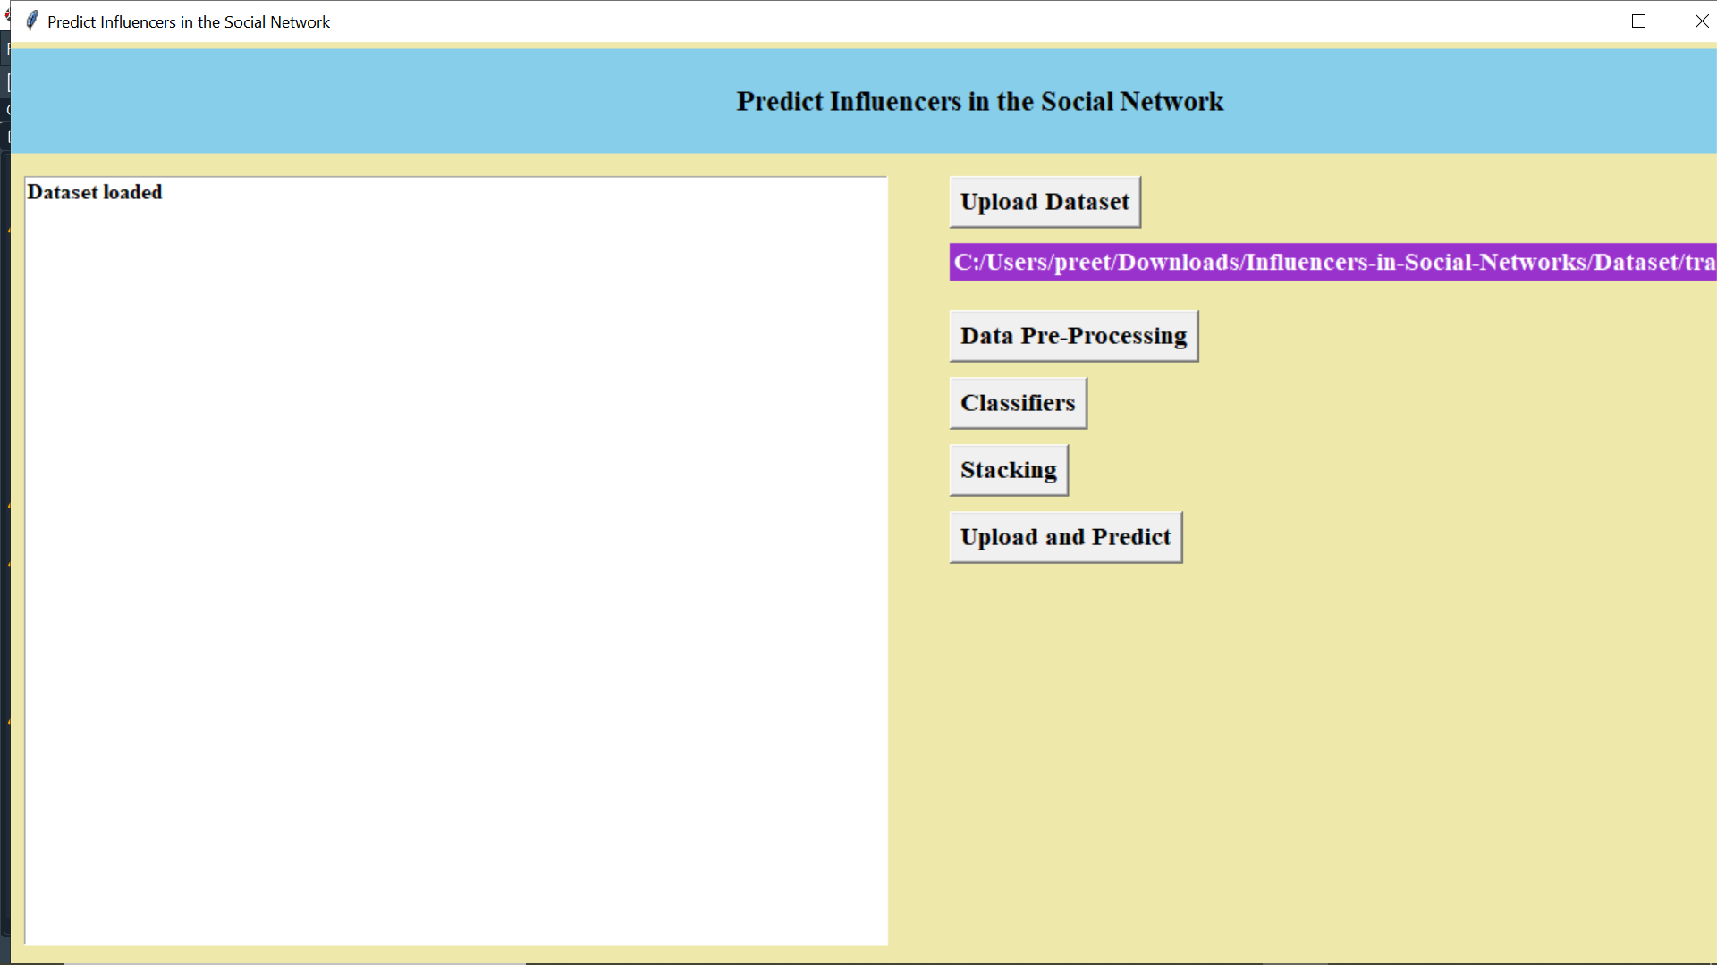

Slide 15
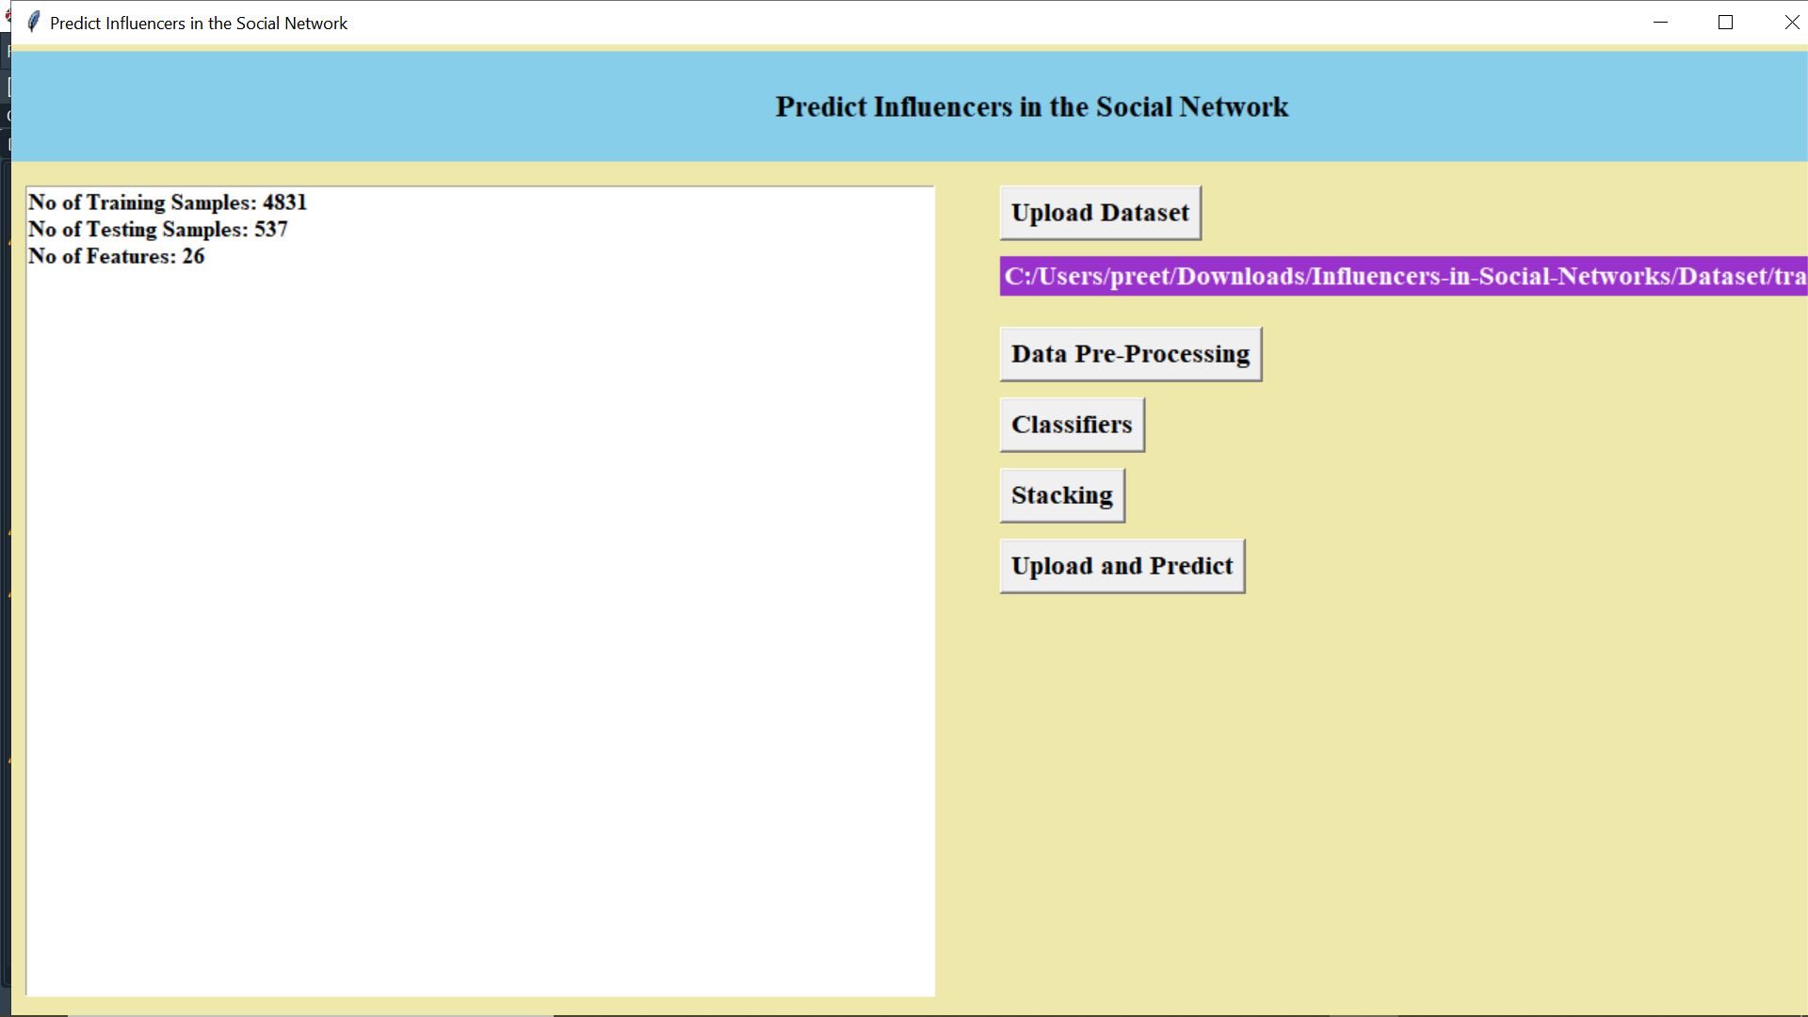

Slide 16
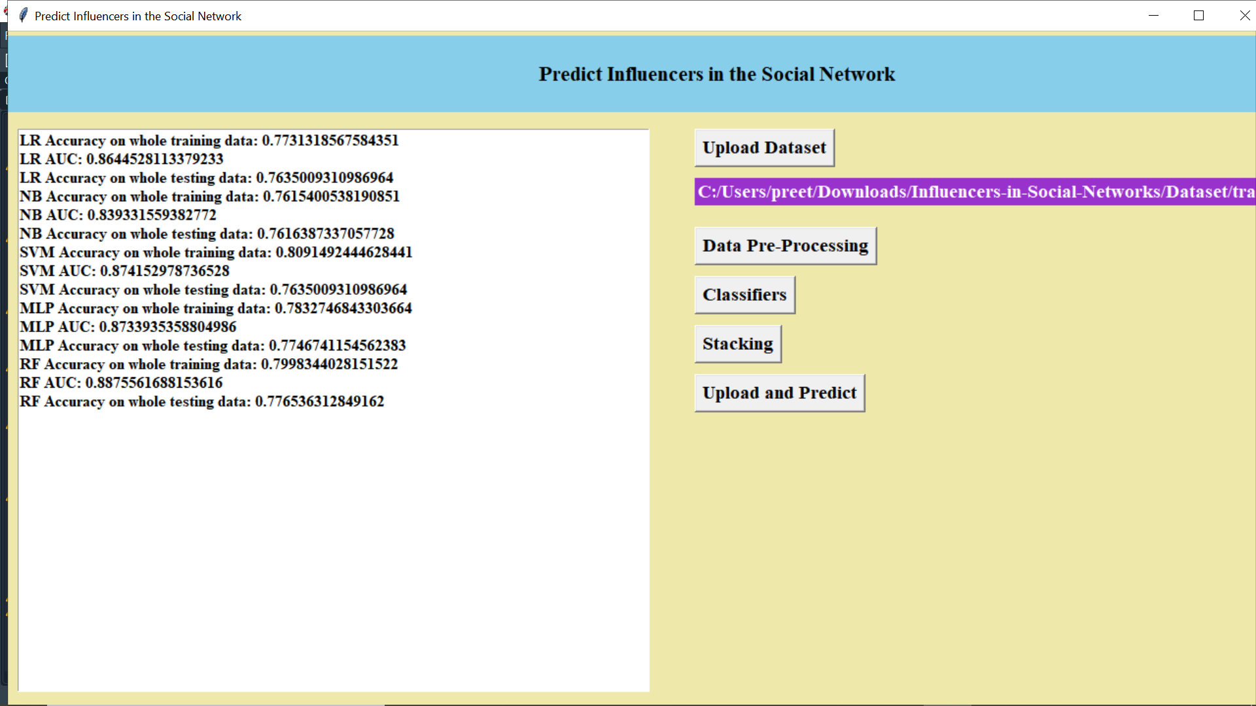

Slide 17
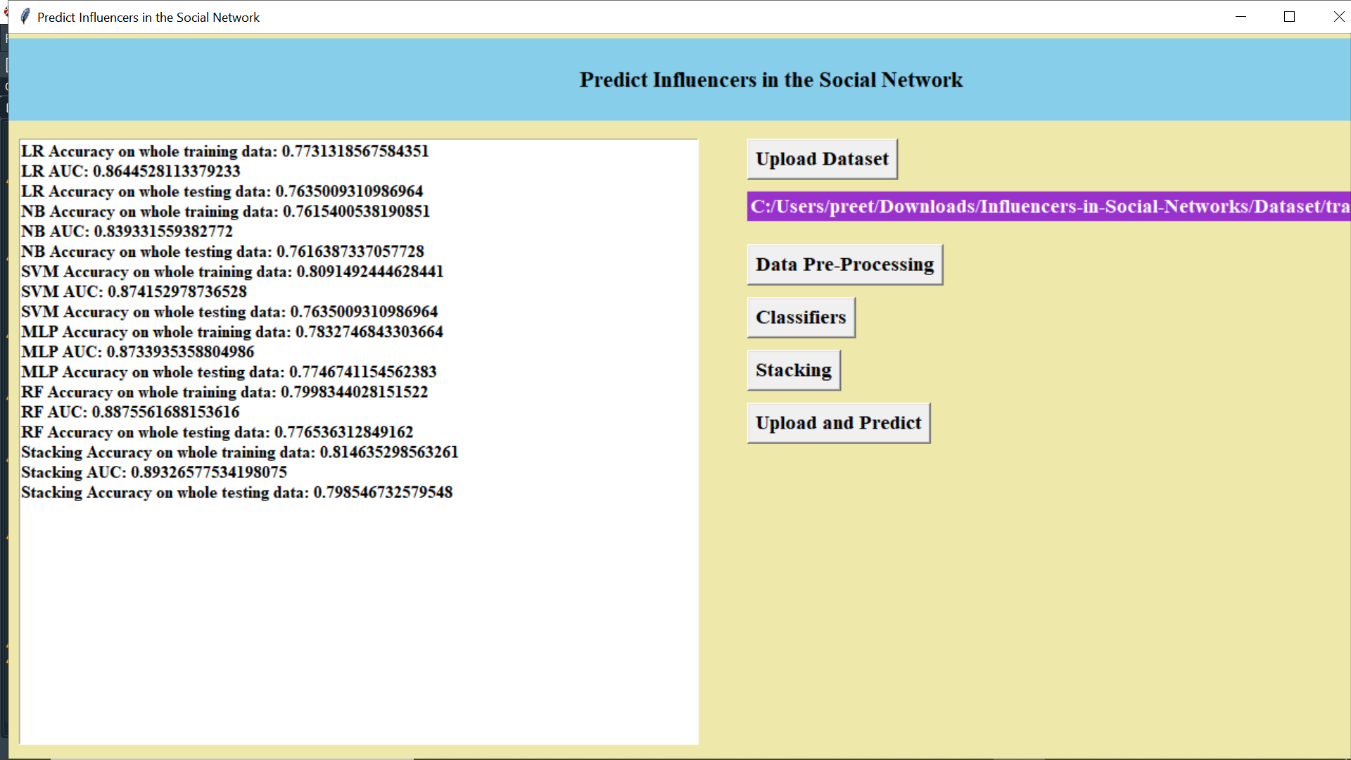

Slide 18
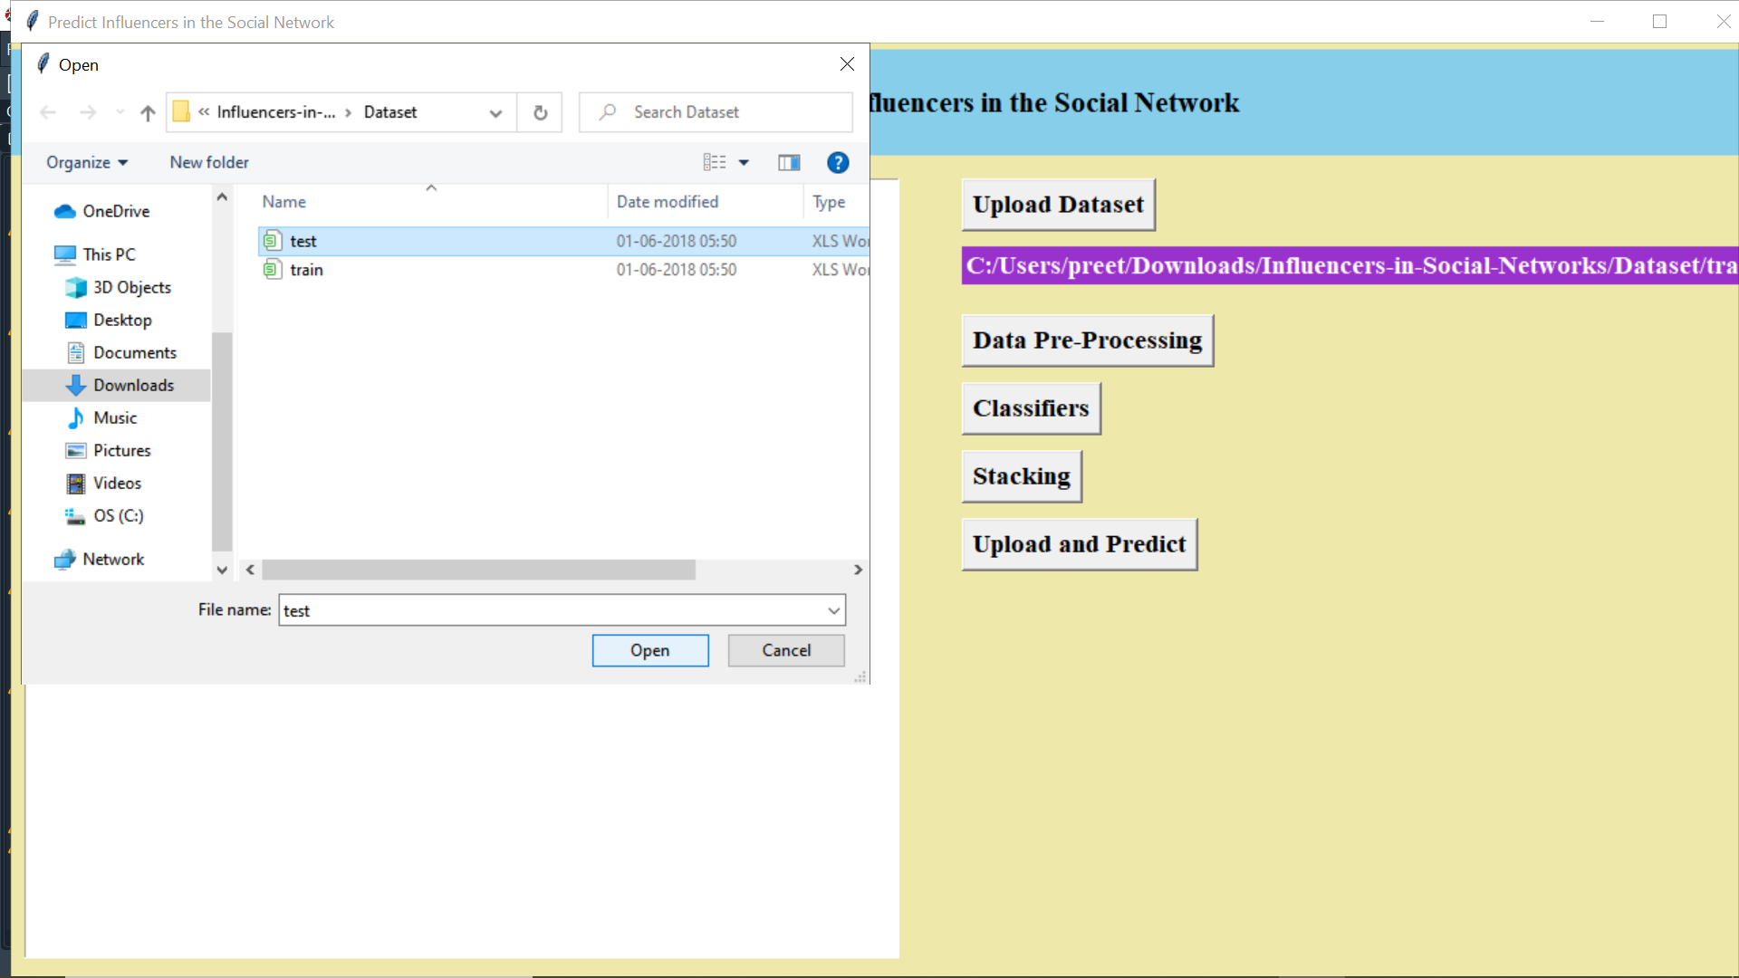

Slide 19
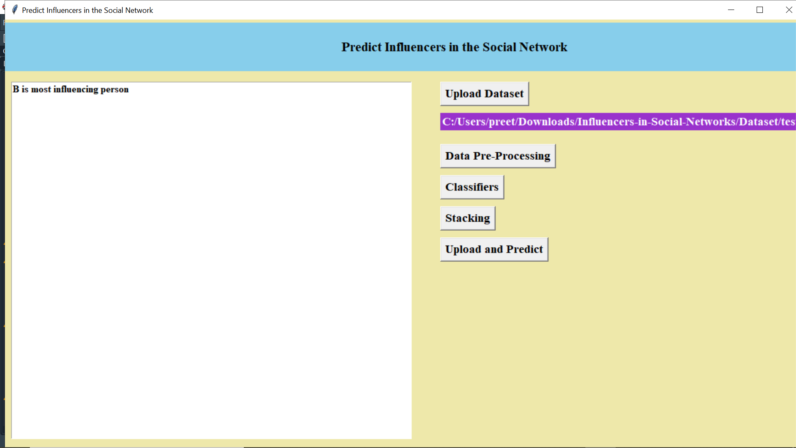

Slide 20
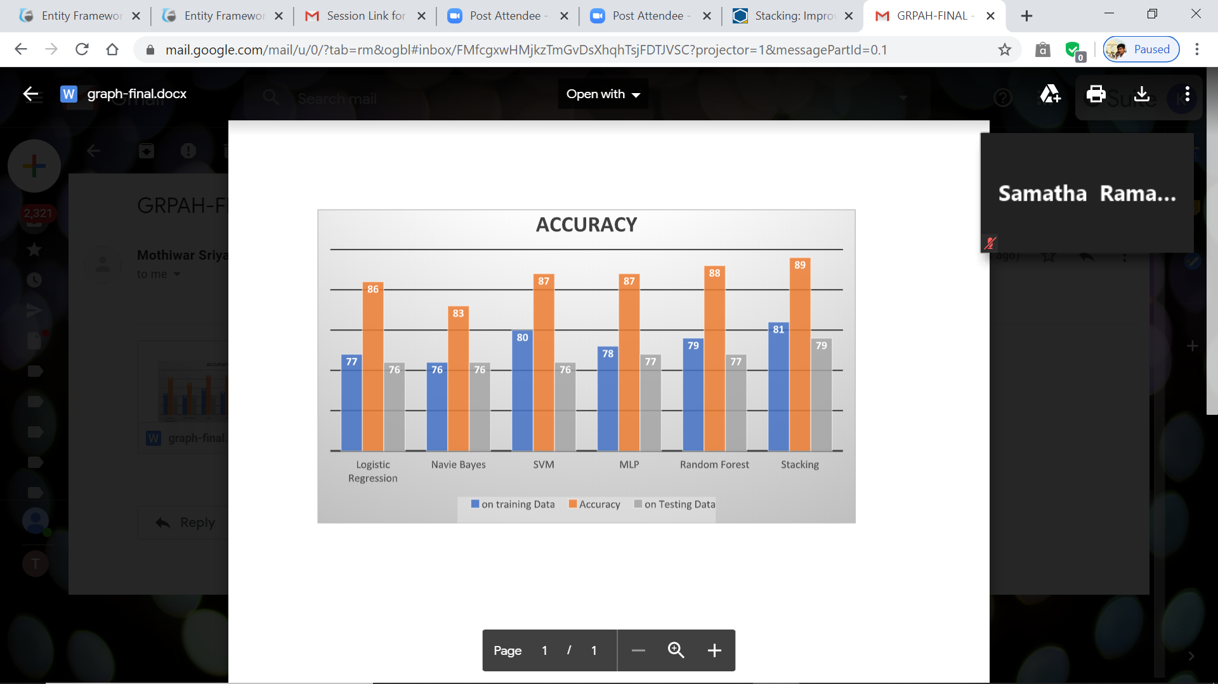
Graph Accuracy

Slide 21
Action Plan
Module Information | Status | Time required to Complete
Literature Survey | Completed | 1week
Requirement Analysis | Completed | 1 week
Design | Completed | 2 weeks
Implementation | Completed | 3 weeks
Documentation | Completed | 2 weeks
Final Submission | Completed | 1 week

Slide 22
References
[1] J. Furnkranz and E. Hullermeier. Preference Learning: A Tutorial Introducton, DS 2011, Espoo, , Oct 2011.Finland
[2] Hsu C W, Chang C C, Lin C J. A practical guide to support vector classification[J]. 2003.
[3] Chang C C, Lin C J. LIBSVM: a library for support vector machines[J]. ACM Transactions on Intelligent Systems and Technology (TIST), 2011, 2(3): 27.
[4] Swingler K. Applying neural networks: a practical guide[M].Morgan Kaufmann, 1996.\
[5] M. Cha, H. Haddadi, F. Benevenuto, and K. P. Gummadi. Measuring user influence in twitter: The million follower fallacy. In Proceedings of the 2010 International AAAI Conference on Weblogs and Social Media, 2010.http://cs229.stanford.edu

Slide 23


